Slide 1
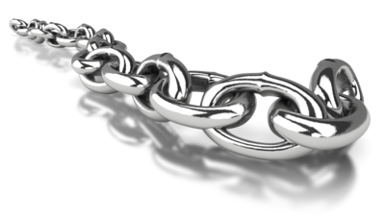
Introduction to Blockchain

Slide 2
What Is Blockchain Technology?
What is Blockchain?
What are Distributed ledgers?
What is Bitcoin?

Slide 3

Blockchain example
Current world scenario: Transaction within same bank:
Barclays Bank
5
Alice
Bob
Barclays Ledger before transaction :
Barclays Ledger after transaction :
Id | Holder | Currency | Amount
1 | Alice | USD | 10
2 | Bob | USD | 5
Id | Holder | Currency | Amount
1 | Alice | USD | 5
2 | Bob | USD | 10

Slide 4
Blockchain example (contd..)
Current World Scenario: Transaction between different banks:
Barclays Bank
Interface
HSBC Bank
5
Alice
Correspondent Banking Arrangement
Charlie
Barclays Ledger before transaction :
HSBC Ledger before transaction :
Id | Holder | Currency | Amount
1 | Alice | USD | 10
2 | HSBC | USD | 1000
Id | Holder | Currency | Amount
1 | Charlie | USD | 5
2 | Barclays | USD | -1000
Barclays Ledger after transaction :
HSBC Ledger after transaction :
Id | Holder | Currency | Amount
1 | Alice | USD | 5
2 | HSBC | USD | 995
Id | Holder | Currency | Amount
1 | Charlie | USD | 10
2 | Barclays | USD | -995
Notes:
Correspondent Banking arrangement: The correspondent banking arrangement allows banks to facilitate payments between their respective customers, by creating Bank accounts as you can see on the screen. Barclays owe HSBC 1000$ and it is depicted in the ledgers of both Barclays and HSBC. It only works if the two banks have a direct relationship with each other. If they don’t, you either can’t make the payment or need to route it through a third (or fourth!) bank until you can complete a path between the two banks
SWIFT messaging: The SWIFT network exists to allow banks securely to exchange electronic messages with each other
RTGS (Real Time Gross Settlement): If the major banks in a country all hold accounts with the central bank (RBI) then they can move money between themselves simply by instructing the central bank to debit one account and credit the other

Slide 5
What are the issues with Current World Systems?
Key Issues with existing systems – 
Need for an interface between the banks
Need to maintain correspondent banking arrangement
Reconciliation of data
Duplication of data
Different systems for Auditors
Duplication of logic for processing the transactions
Huge cost

Slide 6
Blockchain example (contd..)
Blockchain World Scenario: Transaction between different banks:
Barclays Bank
HSBC Bank
5
Alice
Charlie
Distributed Ledger before transaction :
Id | Issuer | Holder | Currency | Amount
1 | Barclays | Alice | USD | 10
2 | HSBC | Charlie | USD | 5
Distributed Ledger after transaction :
Id | Issuer | Holder | Currency | Amount
1 | Barclays | Alice | USD | 5
2 | HSBC | Charlie | USD | 10

Slide 7
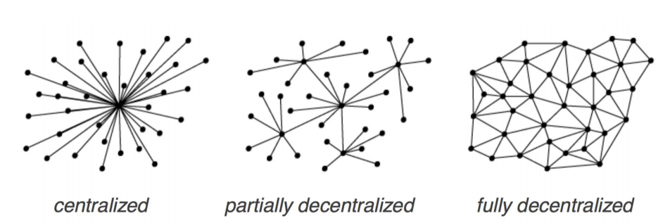
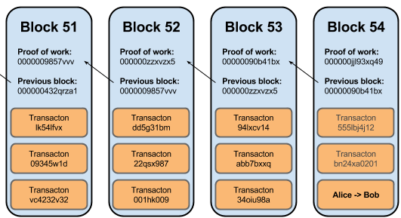
What Is Blockchain Technology? Lets revisit again…
Distributed ledgers are systems that enable parties
who dont fully trust each other
to form and maintain consensus
about the existence, status and evolution of a set of shared facts
spread across multiple sites/countries/institutions (nodes)
A Blockchain is
a type of distributed ledger
comprised of unchangeable, digitally recorded data(transactions)
bundled in packages called blocks
these blocks are linked to each other to form a chain
Notes:
DL Transfer value at-a-distance with no trusted third party. There is no central system. The value is transferred using smart contract
To give an example, Ethereum, Hyperledger are Blockchains and R3 Corda is a distributed ledger

Slide 8
What Is Blockchain Technology? Lets revisit again…
How is Distributed Ledgers different from distributed databases?
Distributed databases don’t have different nodes being run by different parties
In Distributed databases, all nodes are under the control of a central party
What is difference between Bitcoin and Blockchain?
Bitcoin is virtual crypto currency
Blockchain is the backend system which stores Bitcoin on to the Distributed Ledger

Slide 9
Need for Distributed Ledgers… The Finance IT problem statement…
Problem Statement - In finance, parties don't fully trust each other but need to build consensus among them about shared facts – agreements, contracts, deals and so on.
Key Issues with existing Finance IT systems – 
proliferation of systems that exists between financial institutions 
the same information is recorded in multiple places by different parties in different systems all slightly different
there is a huge amount of work through reconciliation, matching to bring their systems back into consensus
the existing platforms or solutions are not designed to solve the problem statement
The Distributed Ledger Technology can bring in consensus and remove discrepancies, duplication and errors in the existing IT systems resulting in
same data “view” across all shared parties
reduction in cost and duplication out of IT systems
same data processing logic across all shared parties to process the data (smart contract)

Slide 10



What are the major Blockchain Components ?
Decentralized
Validity & Consensus
Cryptographically Secure Authentication
Digital Asset
Unique & Immutable Ledger
Smart Contract
Notes:
Cryptographically secure Authentication – Every action taken by the systems of the parties is associated with a private key
Data and Smart contract – A smart-contract is an event-driven program, with state, which runs on a replicated, shared ledger and which can take custody over assets on that ledger
Decentralized – Data can be added by any party involved in the transaction. There is no central authority
Unique Ledger - The “anti-double-spend” feature of blockchains
Immutable Ledger - once committed, nobody else will accept a transaction from me if it tries to build on a modified version of some data that has already been accepted by other stakeholders
Consensus - Consensus is a method for validating the order of requests, or transactions, on a blockchain network. E.g. PoW, PoS, PBFT based on the product platform

Slide 11
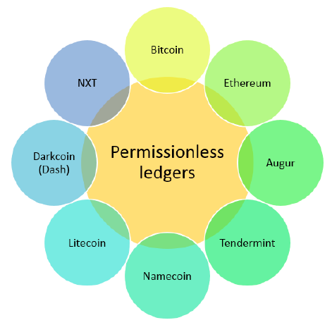
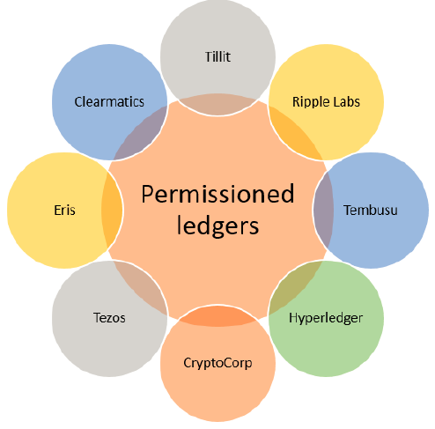
Types of Distributed Ledgers
Notes:
Permissionless Ledger – These are ledger
- running on public network
- with no censorship over the assets being stored in the
- are slow by design, bitcoin takes 10 mins to mine a block
consensus voting is by “proof of work/sacrifice”
In Permissioned Ledger
- nothing to do with censorship-resistance
- nothing to do with cryptocurrencies.
- The idea, instead, is to move from each firm having its own systems of record to having systems of record at the level of the industry. Build API
- the Consensus voting is through protocols that assume known actors

Slide 12
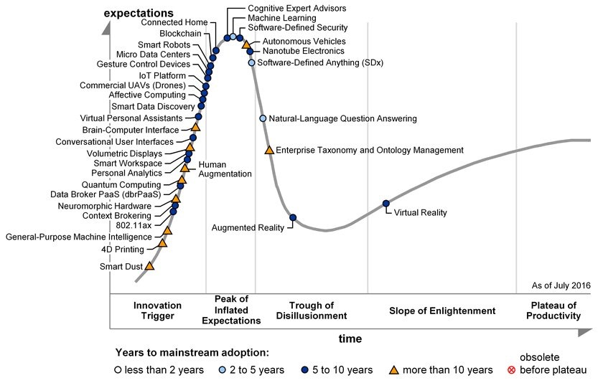
Gartner Emerging Technology Hype Cycle July 2016
Notes:
Gartner Hype Cycle for Emerging Technologies 2016 is based on multiple trends.
Blockchain, still five to ten years from mainstream adoption, nears the peak of the Gartner Hype Cycle for Emerging Technologies, 2016 under the platform revolution trend.
Blockchain is gaining traction because it holds the promise to transform industry operating models

Slide 13


Benefits of Blockchain Implementation
$
Reduce Cost
75 %
Potential savings projected by a leading insurer with implementing a Catastrophe Bond on a blockchain.
Removes cost of intermediaries
Smart contracts reduce manual processing, re-work and processing errors
$20B
Blockchain technologies could reduce banks' infrastructural costs by $15-20bn a year by 2022.
Increase Revenue
$10B
UBS donated blockchain-based trading platform to be used to raise $10B selling social impact bonds.
New Products and Services
Grammy nominated artist Imogen Heap launched her single ‘Tiny Human’ on a blockchain based platform Ujo Music to her 2M Twitter followers.
2M
Reduce Risk
360º
A leading insurer is looking to implement a KYC solution to build a 360º Customer view on a blockchain.
No single point of failure or attack
Non-repudiability reduces risk of fraud
Immutability and provenance preserves audit trail
$10B
Global spend on Anti-Money Laundering compliance alone is estimated at $10B.
Increase Speed and Customer Satisfaction
0
Several trading houses are looking to leverage blockchain technologies to allow T+0 trade settlements.
Allows T+0 settlement
Simplifies supply chain removing intermediaries
Guarantees supply chain provenance

Slide 14
What use cases are suited for Blockchain?
Lightweight financial systems:
A Financial system which will allow a group of financial entities to transact and exchange assets between them
e.g.: loyalty points, banking applications
Provenance tracking:
Tracking the origin and movement of high value assets across a supply chain
e.g.: movement of high value items across supply chain, land registry
Interorganizational record keeping:
Blockchain can provide a mechanism for collectively recording and notarizing any type of data, whose meaning can be financial or otherwise
e.g.: KYC
Multiparty aggregation:
This usecase is technically same as above but the motivation is different - to overcome the infrastructural difficulty of combining information from a large number of separate sources
e.g.: reciprocal sharing arrangement for common customer set across banks
Notes:
Lightweight financial systems: A Financial system which will allow a group of financial entities to transact and exchange assets between them.
e.g. crowdfunding, gift cards, loyalty points
Benefit: the lower cost and friction of blockchains provides an immediate benefit, while the loss of confidentiality is not a concern
Provenance tracking: Tracking the origin and movement of high value items across a supply chain, such as luxury goods, pharmaceuticals, cosmetics and electronics
Benefit: There’s a benefit to distributed trust. No matter where a centralized database is held, there will be people in that place who have the ability (and can be bribed) to corrupt its contents, marking forged or stolen items as legit
Interorganizational record keeping: use cases which is not related to assets. Instead, the chain acts as a mechanism for collectively recording and notarizing any type of data
e.g. KYC, Land Registry
Multiparty aggregation: Same as above but motive is to overcome the infrastructural difficulty of combining information from a large number of separate sources
e.g. reciprocal sharing arrangement in which banks exchange verification data to avoid duplicated work for common customers, implemented using standard master– slave data replication, in which each bank maintains a live readonly copy of the other’s database

Slide 15
Issues/Concerns of Blockchain
Blockchains are not suited for high frequency transaction volumes. A Bitcoin transaction, by design, will get one confirmation after an average of 10 minutes.
Irreversible transactions
Shift from centralized authority to and autonomous, digital and decentralized network for trusted P2P transactions challenges societal and economic norms
High Deployment cost as the size of decentralized ledger will be bigger than the centralized ledger
Notes:
Blockchains are not suited for high frequency transaction volumes: Blockchain’s performance is determined by network performance, as it is the network that limits the number of transactions in a block (block size) and the time between blocks (dwell time). Takes 10 mins to create block in bitcoin
Irreversible transactions (e.g. the DAO Hack): Once committed you cannot reverse the transaction. So what is the DAO hack.. The DAO—a crowdsourced venture capital platform based on the Ethereum blockchain fell victim to a $60 million dollar hack soon after opening. The attacker/s withdrew Ether from The DAO smart contract multiple times using the same DAO Tokens
The real fix was the nuclear option—a so-called “hard fork” .In this case, a hard fork meant a full rollback of the malicious DAO transactions, essentially rewriting the Ethereum transaction ledger to remove about 12 million Ether tokens from the hackers’ accounts
Shift from centralized authority to and autonomous, digital and decentralized network: facilitating collaboration between market participants and technology leaders, succeeding in the operational transformation, and shaping a stimulating regulatory environment
High Deployment cost as the size of decentralized ledger will be bigger than the centralized ledger

Slide 16
Blockchain Technologies
Hyperledger: Hyperledger is a permissioned, shared ledger developed as part of Linux Foundation. There are currently two incubator projects under the Hyperledger umbrella: “Fabric” and “Sawtooth Lake.
Corda: R3 Corda is a distributed ledger platform designed from the ground up to record, manage and synchronise financial agreements between regulated financial institutions.
Eris (Monax): Platform to connect to various blockchains in a standardized way without the need to learn new commands when switching from one blockchain to another.
Ethereum: Public blockchain platform that can run smart contracts. Has its own cryptocurrency – Ether
BigchainDB: BigchainDB is "a scalable blockchain database” capable of one million writes per second. It is built upon a big data distributed database (RethinkDB) and is capable of blockchain characteristics - decentralized control, immutability, creation and movement of digital assets

Slide 17
Q & A

Slide 18
References
http://www.blockchaintechnologies.com/blockchain-definition
https://gendal.me/2016/11/08/on-distributed-databases-and-distributed-ledgers/
https://www.weforum.org/agenda/2015/11/how-will-blockchain-technology-transform-financial-services/
https://gendal.me/2016/10/25/
Consensus-as-a-service: a brief report on the emergence of permissioned, distributed ledger systems by Tim Swanson
http://www.gartner.com/newsroom/id/3412017
http://www.multichain.com/blog/2016/05/four-genuine-blockchain-use-cases/

